Slide 1
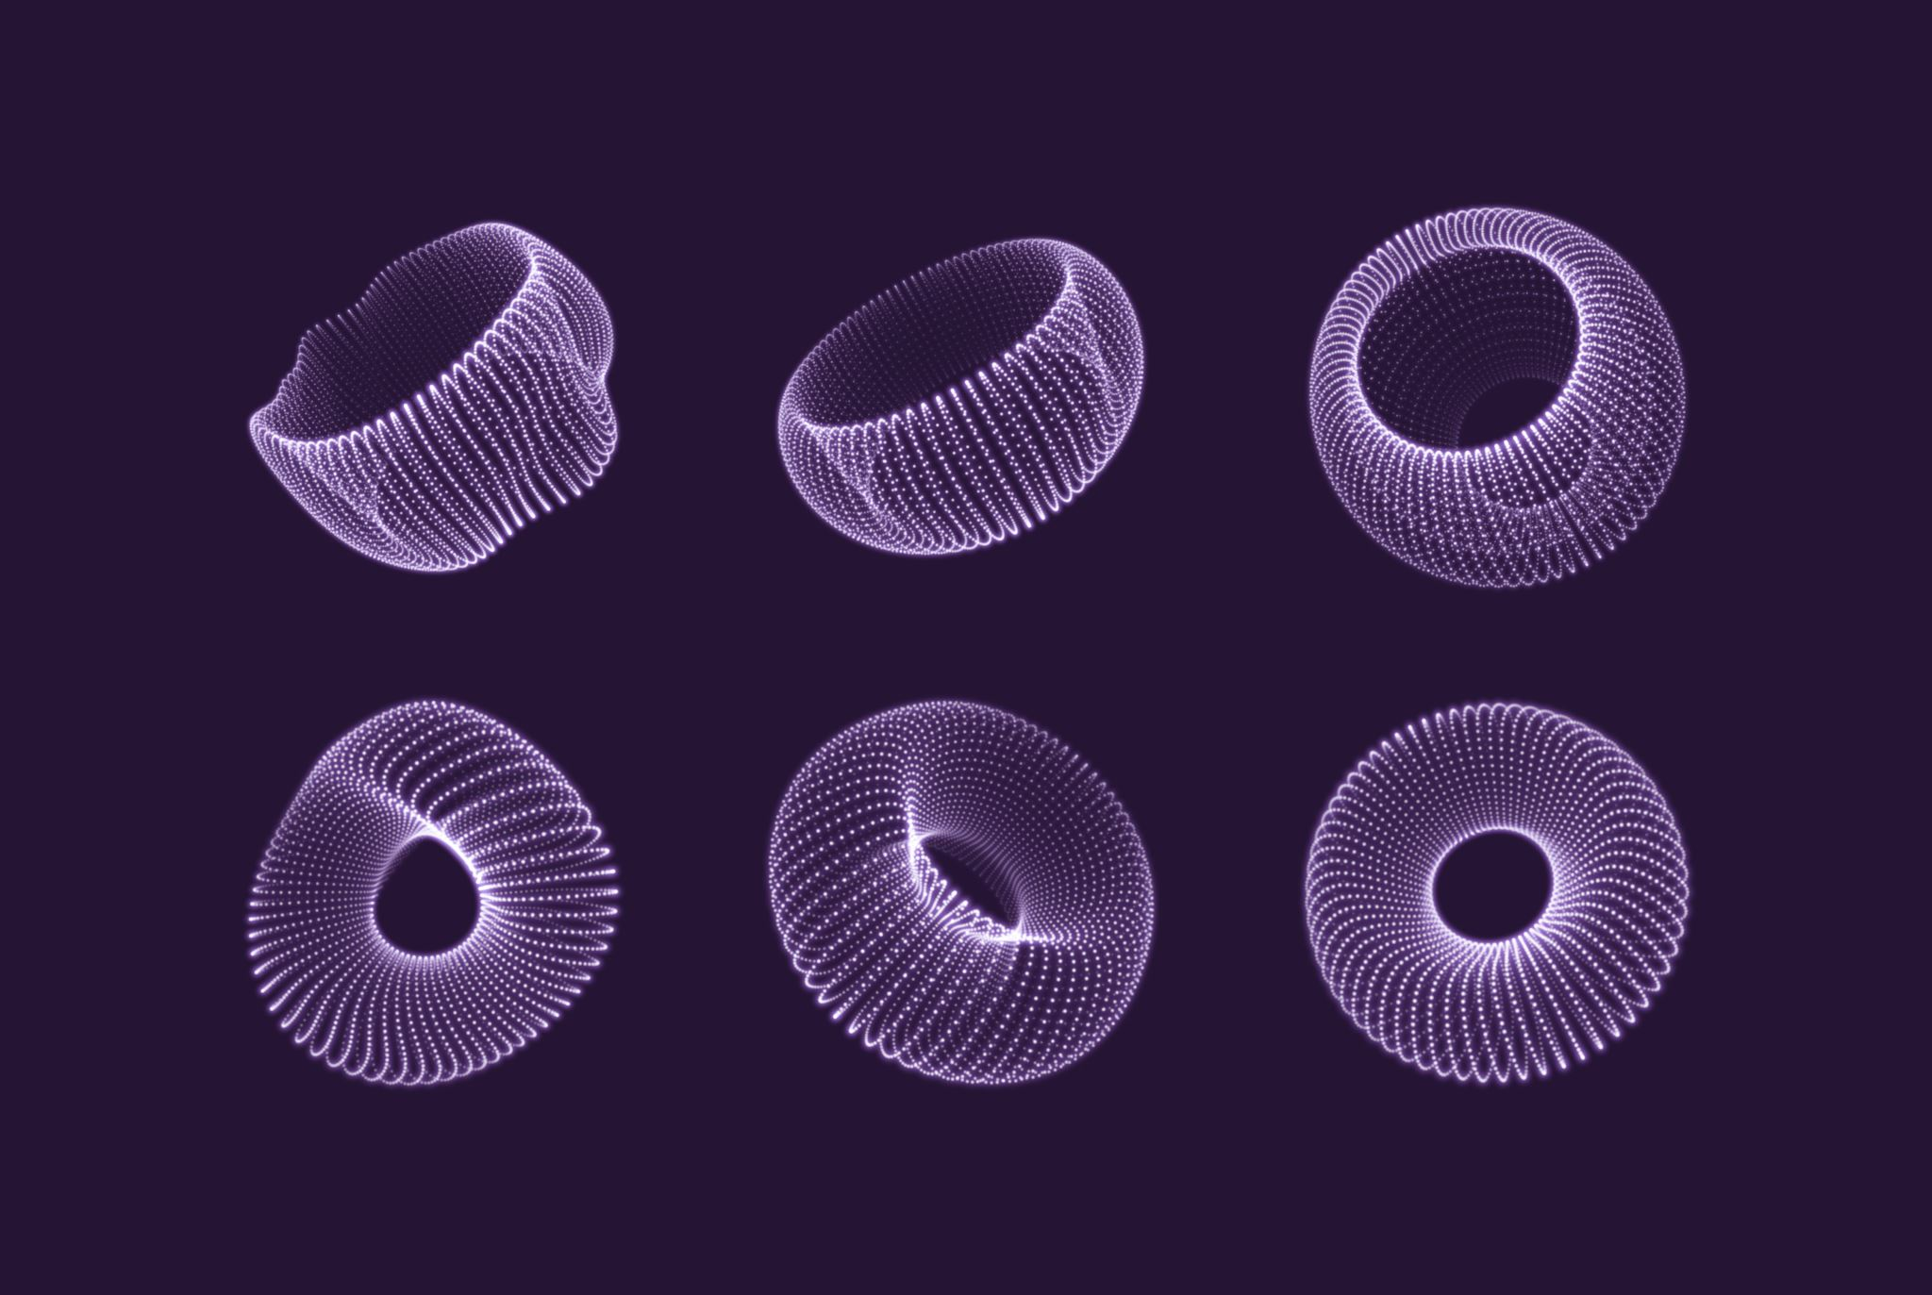
Blender on a Bender
Introduction to Computer Graphics
Marie Biedermann

Slide 2
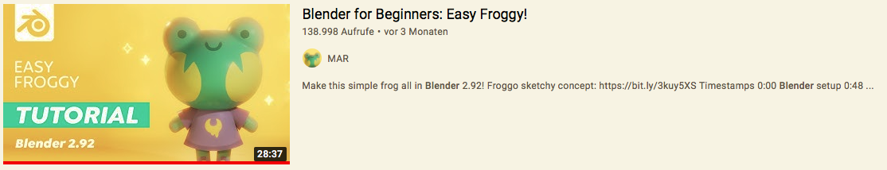
My Project
Youtube Tutorial
No Experience
Cute Frog
What could go wrong?

Slide 3
The answer is…
EVERYTHING!!!!

Slide 4
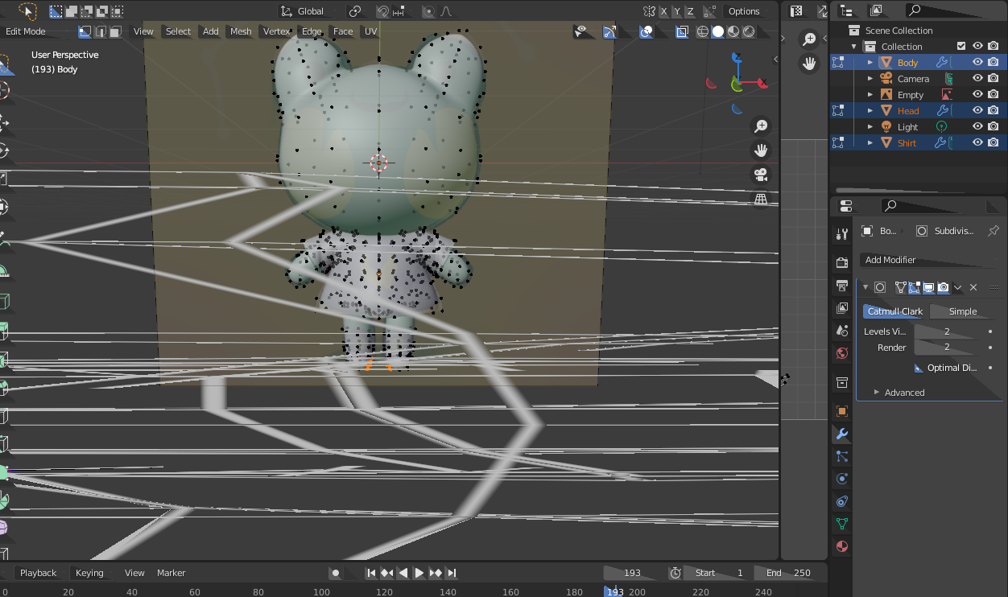
Troubles
Blender crashed
Shading
Creating Material
Render

Slide 5
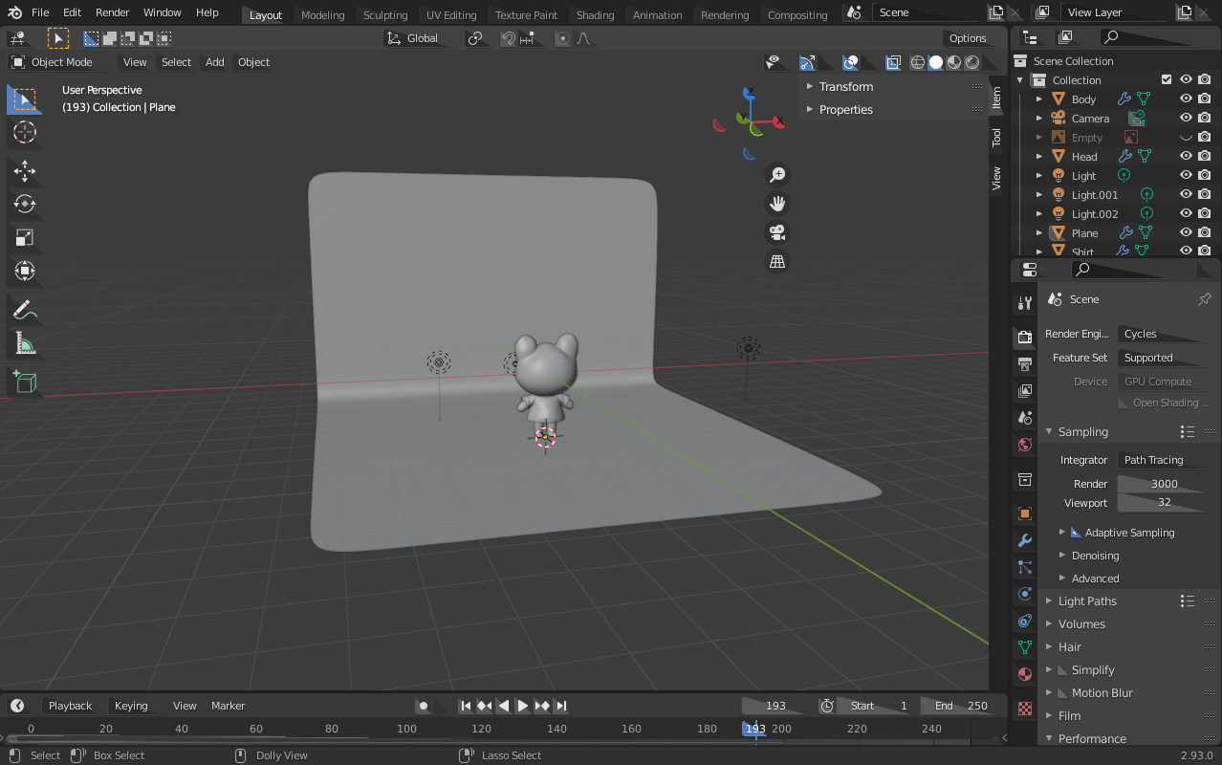
Final Result
Help
Happy that I could achieve this..
Would’ve loved to do more though

Slide 6
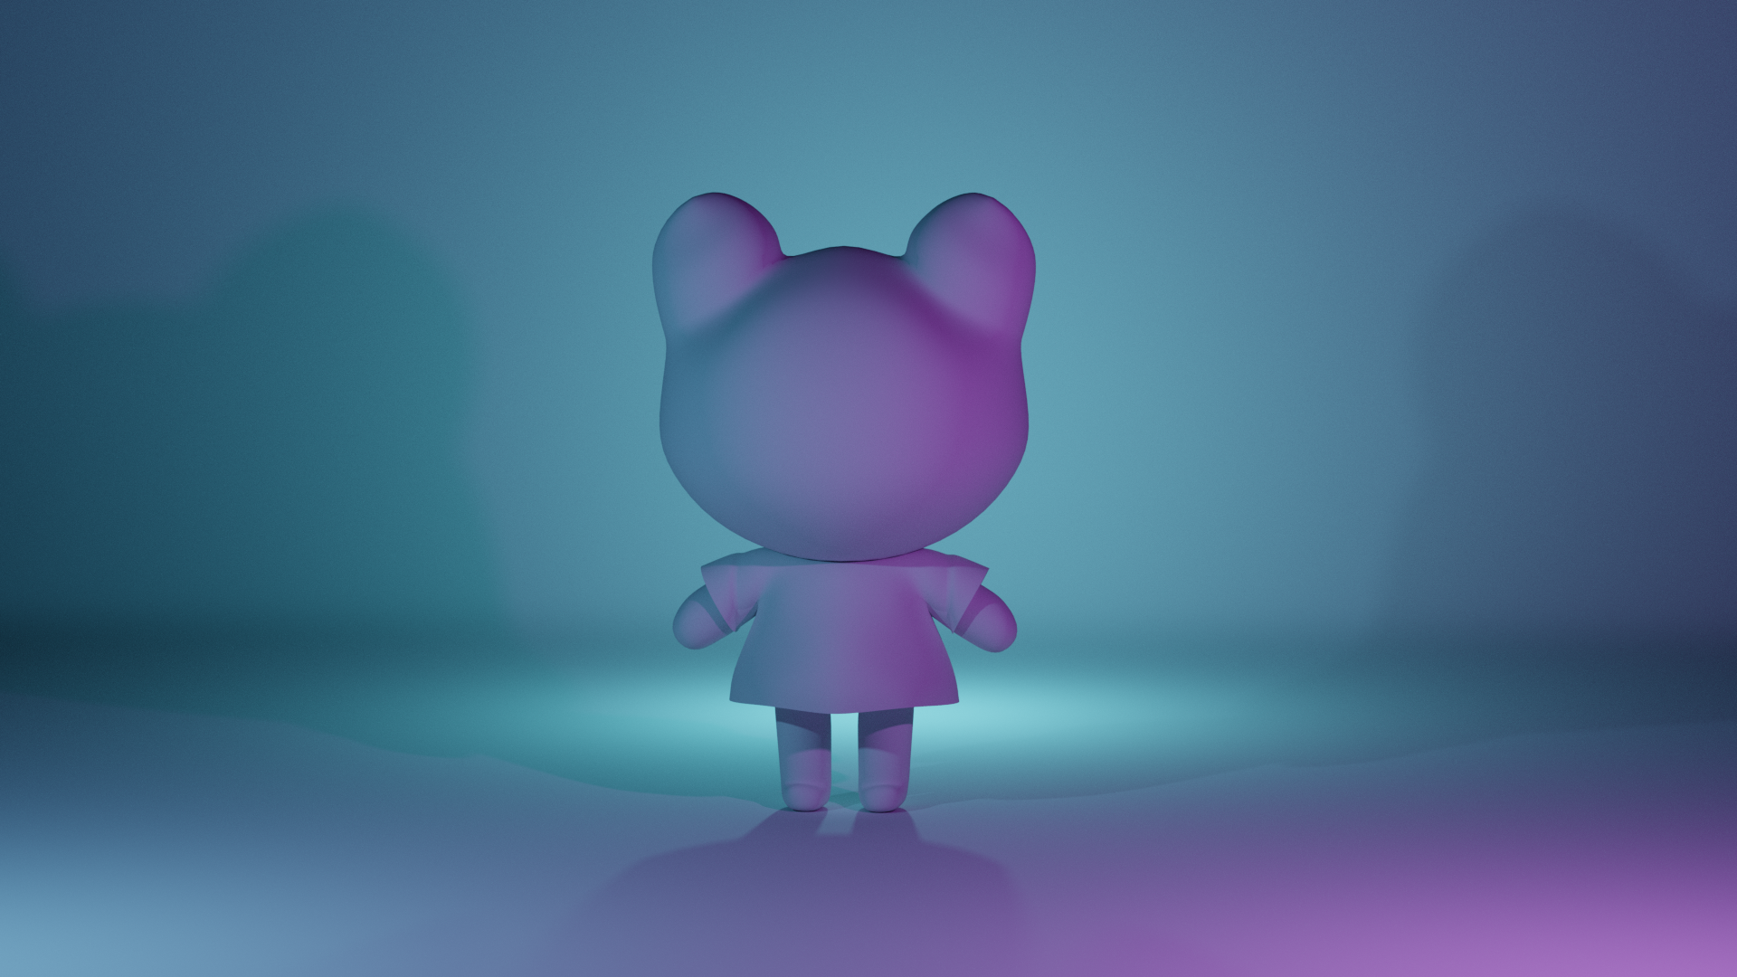
Thank you for your Attention

